Slide 1
Model Analysis

Slide 2
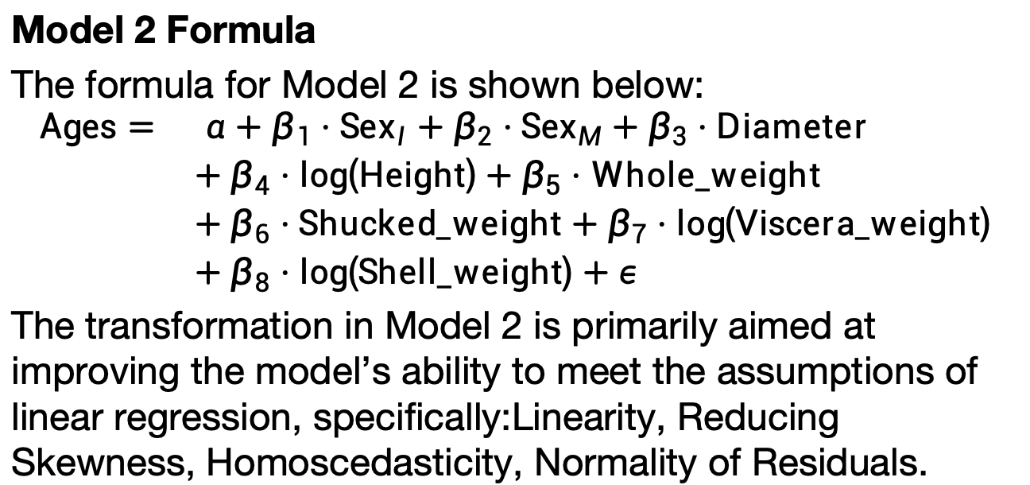
Model 2 and Transformation Explanation
Model 2 Formula
The formula for Model 2 is shown below:
$$\begin{matrix}\text{Ages}= & α+β_{1}⋅{\text{Sex}}_{I}+β_{2}⋅{\text{Sex}}_{M}+β_{3}⋅\text{Diameter} \\ & +β_{4}⋅log\left(\text{Height}\right)+β_{5}⋅\text{Whole}\text{_}\text{weight} \\ & +β_{6}⋅\text{Shucked}\text{_}\text{weight}+β_{7}⋅log\left(\text{Viscera}\text{_}\text{weight}\right) \\ & +β_{8}⋅log\left(\text{Shell}\text{_}\text{weight}\right)+ε\end{matrix}$$
The transformation in Model 2 is primarily aimed at improving the model’s ability to meet the assumptions of linear regression, specifically:Linearity, Reducing Skewness, Homoscedasticity, Normality of Residuals.

Slide 3
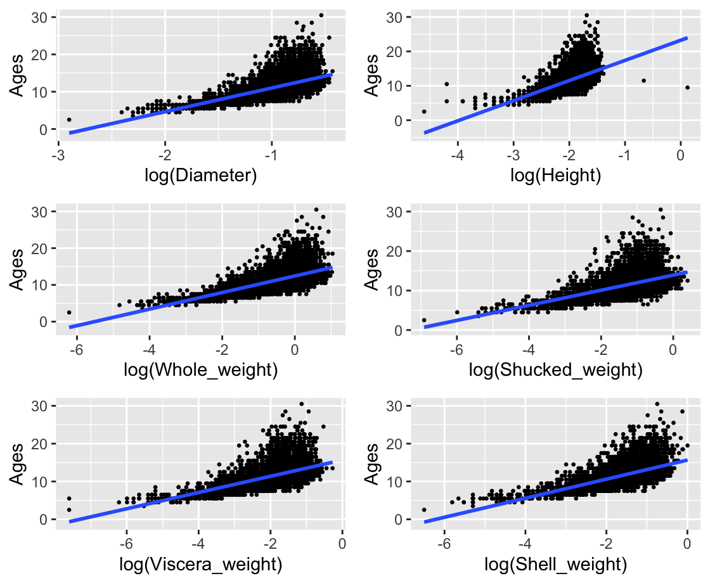
model 2 Linearity check
The log-transformed predictor variables generally exhibit a linear relationship with Ages, as expected in a linear regression model.

Slide 4
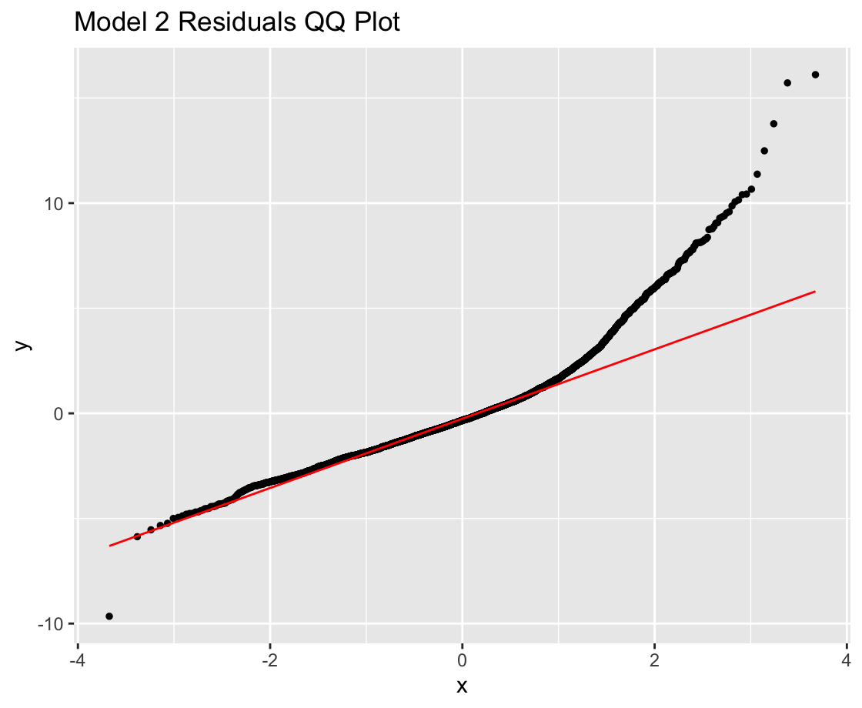
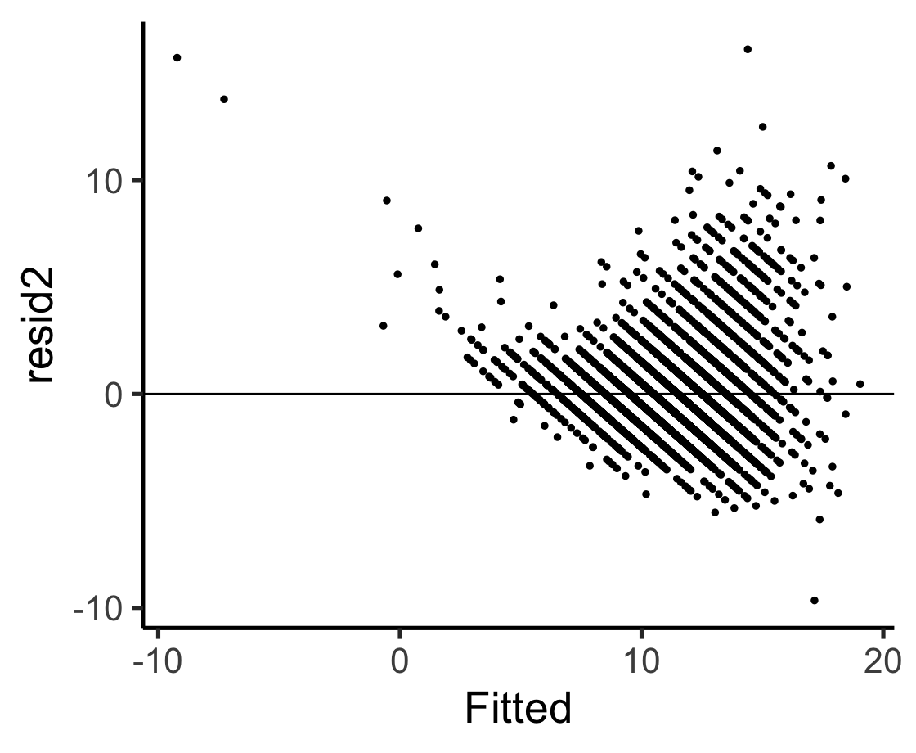
Model 2 exhibits problems with non-normal residuals (especially in the tails) and heteroscedasticity, as seen in both the QQ plot and residuals vs fitted plot. This suggests that the assumptions of linear regression are violated.

Slide 5
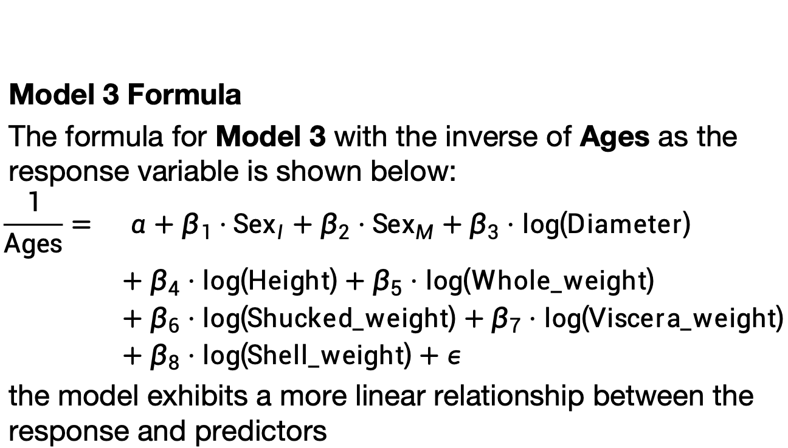
Model 3 Formula
The formula for Model 3 with the inverse of Ages as the response variable is shown below:
$$\begin{matrix}\frac{1}{\text{Ages}}= & α+β_{1}⋅{\text{Sex}}_{I}+β_{2}⋅{\text{Sex}}_{M}+β_{3}⋅log\left(\text{Diameter}\right) \\ & +β_{4}⋅log\left(\text{Height}\right)+β_{5}⋅log\left(\text{Whole}\text{_}\text{weight}\right) \\ & +β_{6}⋅log\left(\text{Shucked}\text{_}\text{weight}\right)+β_{7}⋅log\left(\text{Viscera}\text{_}\text{weight}\right) \\ & +β_{8}⋅log\left(\text{Shell}\text{_}\text{weight}\right)+ε\end{matrix}$$
the model exhibits a more linear relationship between the response and predictors

Slide 6
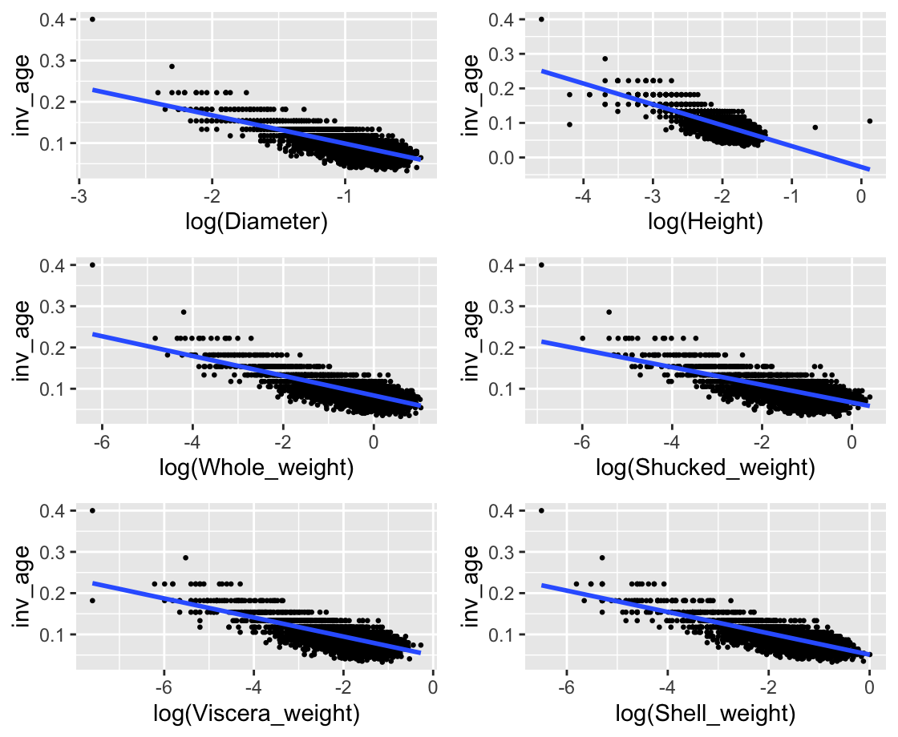
model 3 Linearity check
the model adequately satisfies the linearity assumption, with only minor deviations for some predictors.

Slide 7
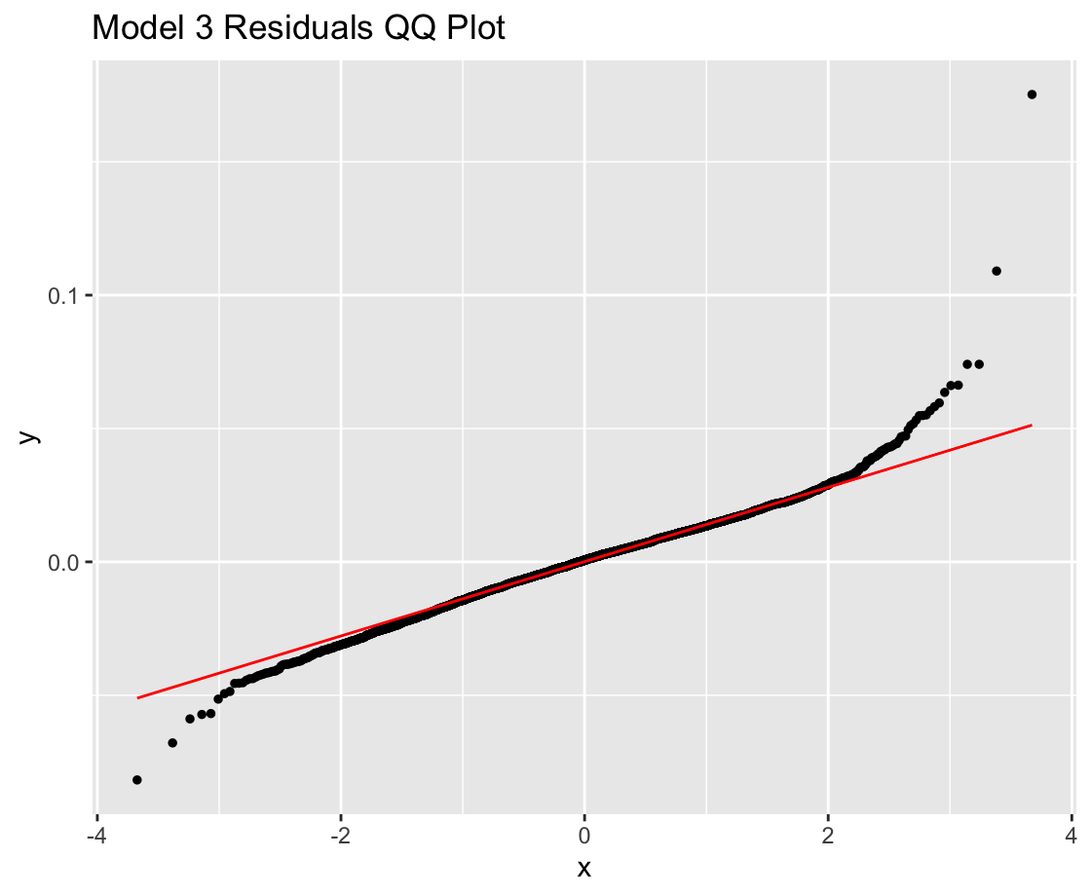
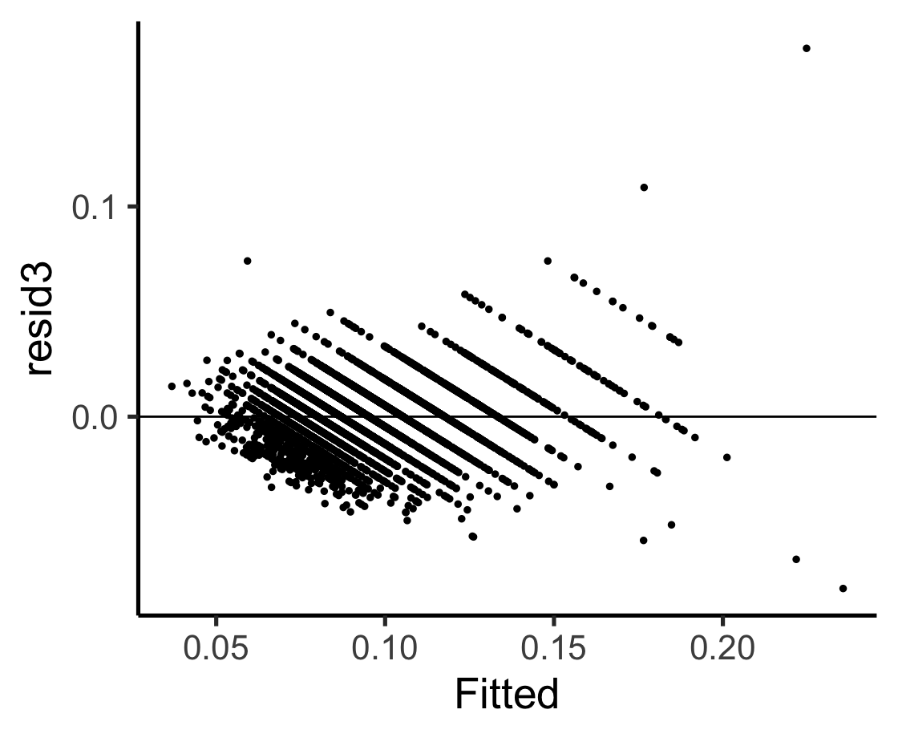
Model 3 improves significantly on these issues, showing better normality of residuals and addressing heteroscedasticity. The inverse transformation applied in Model 3 has helped stabilize the variance and improve the overall model fit.

